Slide 1
Containers Orchestration
SE489: DevOps Engineering

Slide 2
Outline
Why Do we need Container Orchestration?
Container Orchestration
Container Orchestration Tools
What is Kubernetes and How it works
Kubernetes Use Case

Slide 3
Why Do we need Container Orchestration?

Slide 4
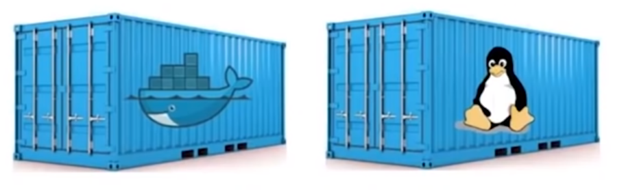
Containers are Good…
Both Linux Containers and Docker Containers
Isolate the application from the host
FASTER, RELIABLE, EFFICIENT, LIGHTWEIGHT, AND SCALABLE

Slide 5
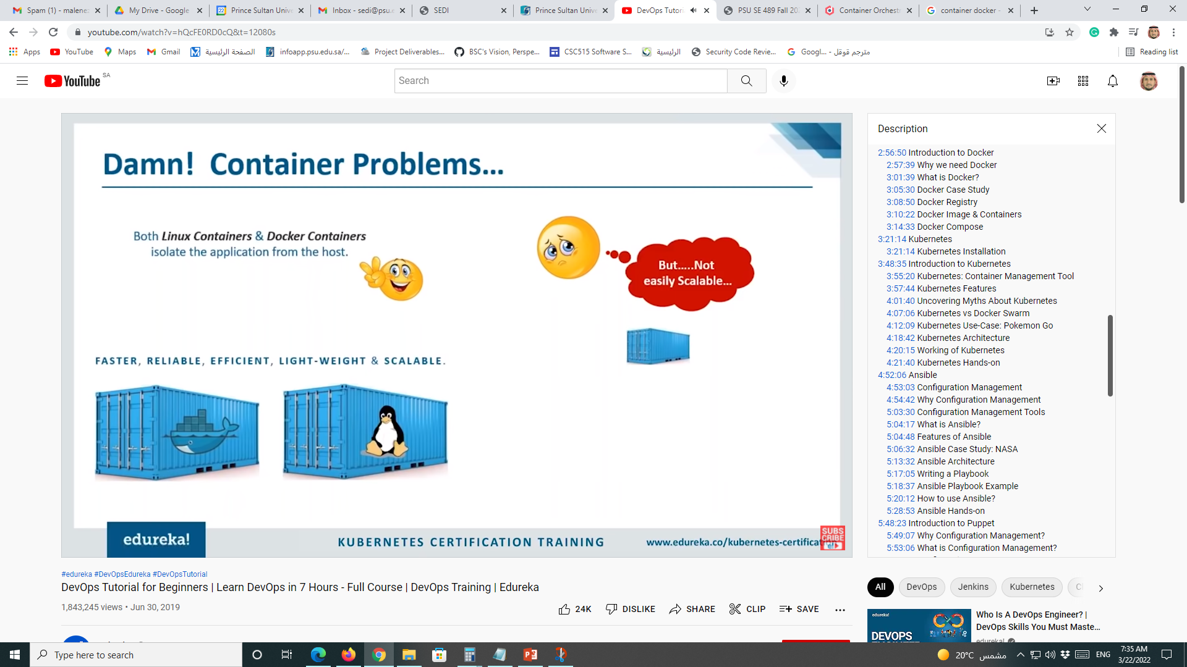
Containers Problems!
Both Linux Containers and Docker Containers
Isolate the application from the host
Not easily Scalable
FASTER, RELIABLE, EFFICIENT, LIGHTWEIGHT, AND SCALABLE

Slide 6
Containers Problems!
Both Linux Containers and Docker Containers
Isolate the application from the host
Not easily Scalable
FASTER, RELIABLE, EFFICIENT, LIGHTWEIGHT, AND SCALABLE

Slide 7
Problems with Scaling up Containers
Containers could communicate with each other
Containers had to be deployed appropriately
Containers had to be managed carefully
Auto scaling was not possible
Distributing traffic was still challenging
It was not Scalable
1
2
3
4
5

Slide 8
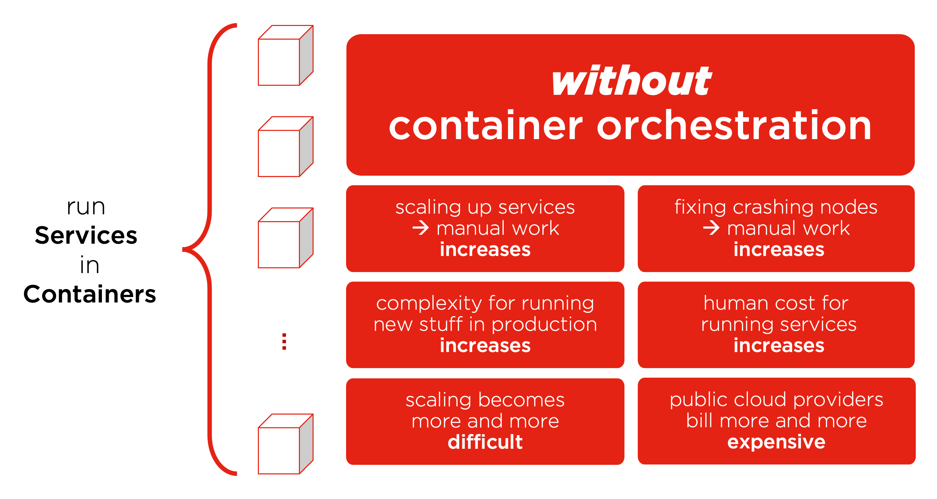
Containers Without Orchestration

Slide 9
Container Orchestration

Slide 10
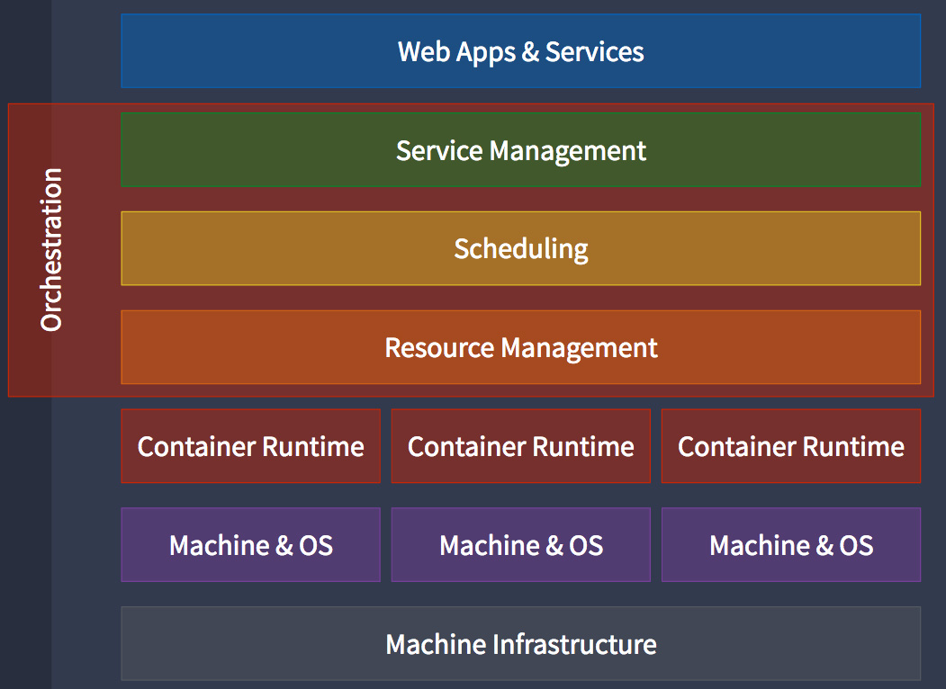
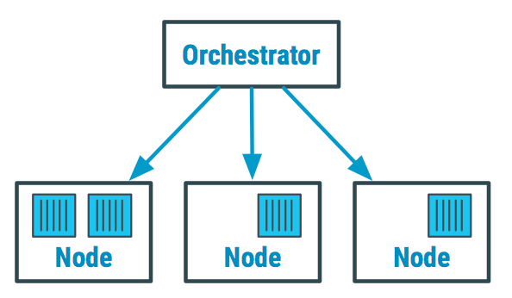
Container Orchestration
Container orchestration automates and simplifies provisioning, and deployment and management of containerized applications.

Slide 11
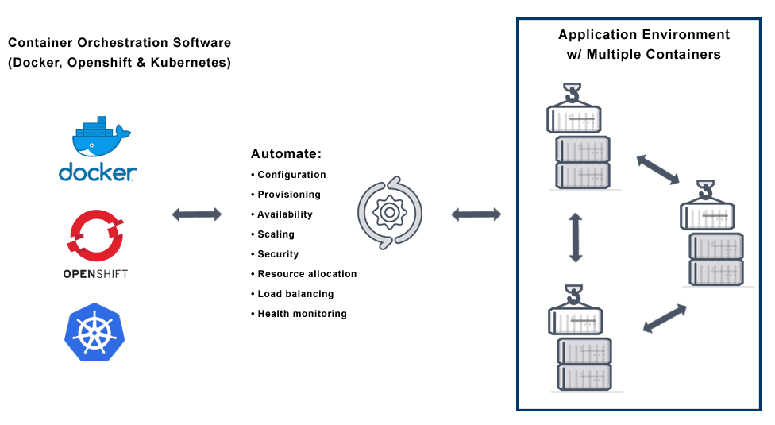
Container Orchestration
Container orchestration is the automatic process of managing or scheduling the work of individual containers for applications based on microservices within multiple clusters.
The widely deployed container orchestration platforms are based on open-source versions like Kubernetes, Docker Swarm or the commercial version from Red Hat OpenShift.

Slide 12
Why Do We Need Container Orchestration?
Container orchestration is used to automate the following tasks at scale:
Configuring and scheduling of containers
Provisioning and deployments of containers
Availability of containers
The configuration of applications in terms of the containers that they run in
Scaling of containers to equally balance application workloads across infrastructure
Allocation of resources between containers
Load balancing, traffic routing and service discovery of containers
Health monitoring of containers
Securing the interactions between containers.

Slide 13
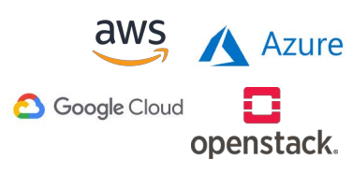
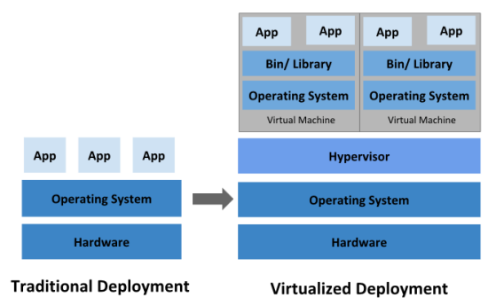
Cloud Orchestration
Infrastructure-as-a-Service (IaaS)
Provisioning virtual machines from a cloud service provider (CSP)

Slide 14
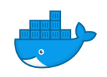
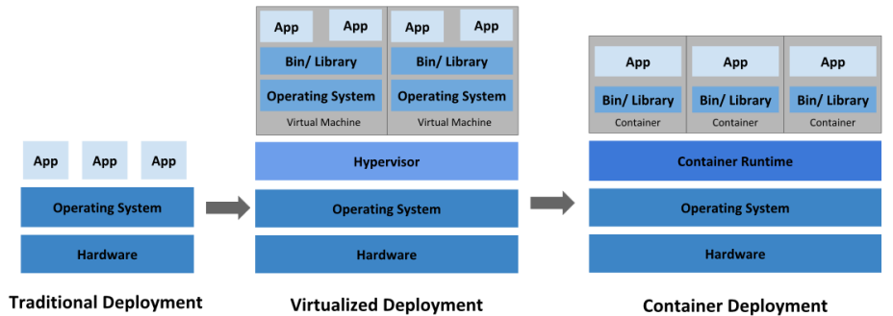
Container Orchestration
Application containers
Lightweight OS-virtualisation
Application packaging for portable, reusable software

Slide 15
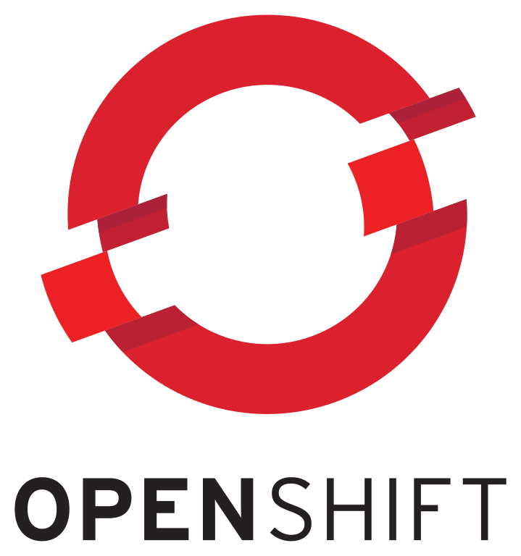
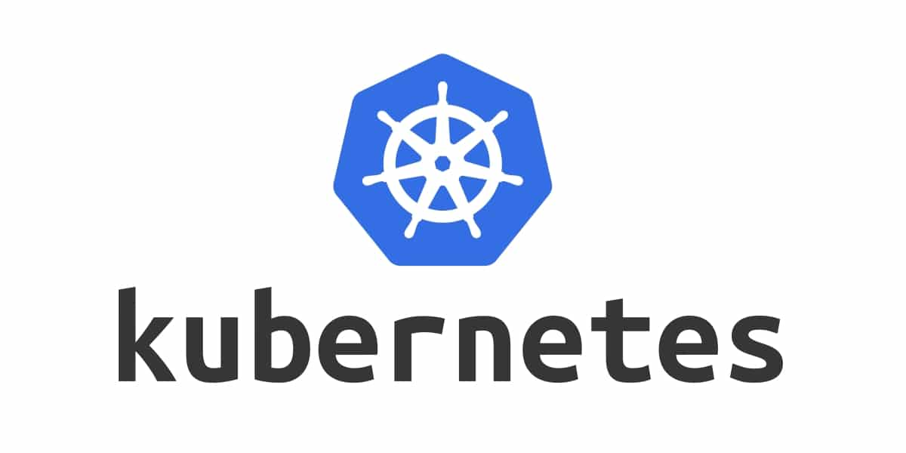
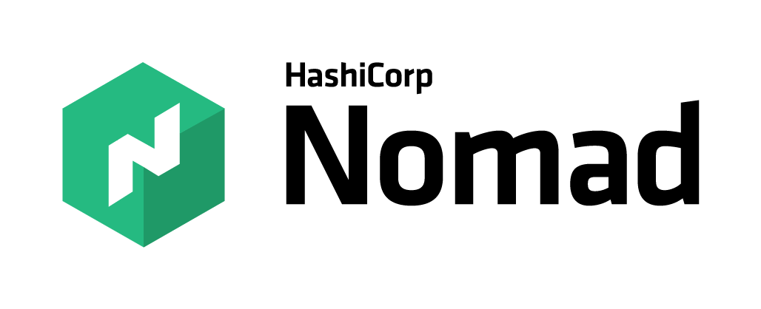
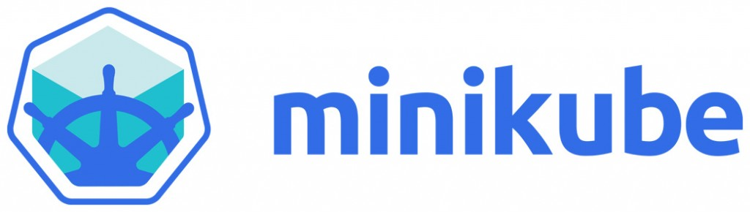
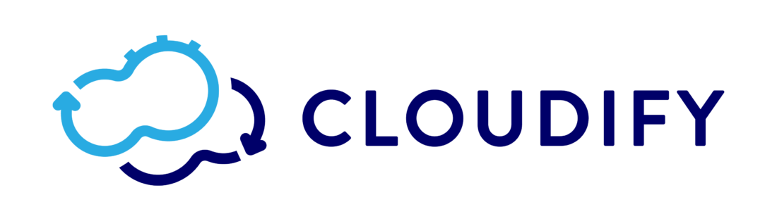
Container Orchestration Tools

Slide 17
What is Kubernetes and How it works

Slide 18
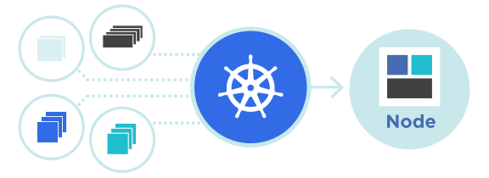
Kubernetes
Kubernetes is an open-source container management tool which automates container deployment, container (de)scaling and container load balancing
Benefits (Works with all cloud vendors (Public, Private (on-premises), and Hybrid))
More about Kubernetes
Developed by Google and written in Golang with a huge community
Can group ‘n’ containers into one logical unit for managing and deploying them

Slide 19
Kubernetes
Container Management Across a Cluster of Nodes (VMs)
Deploys
Maintains
Destroys
Auto-scaling
Self-healing
Rolling updates and rollbacks CI/CD

Slide 20
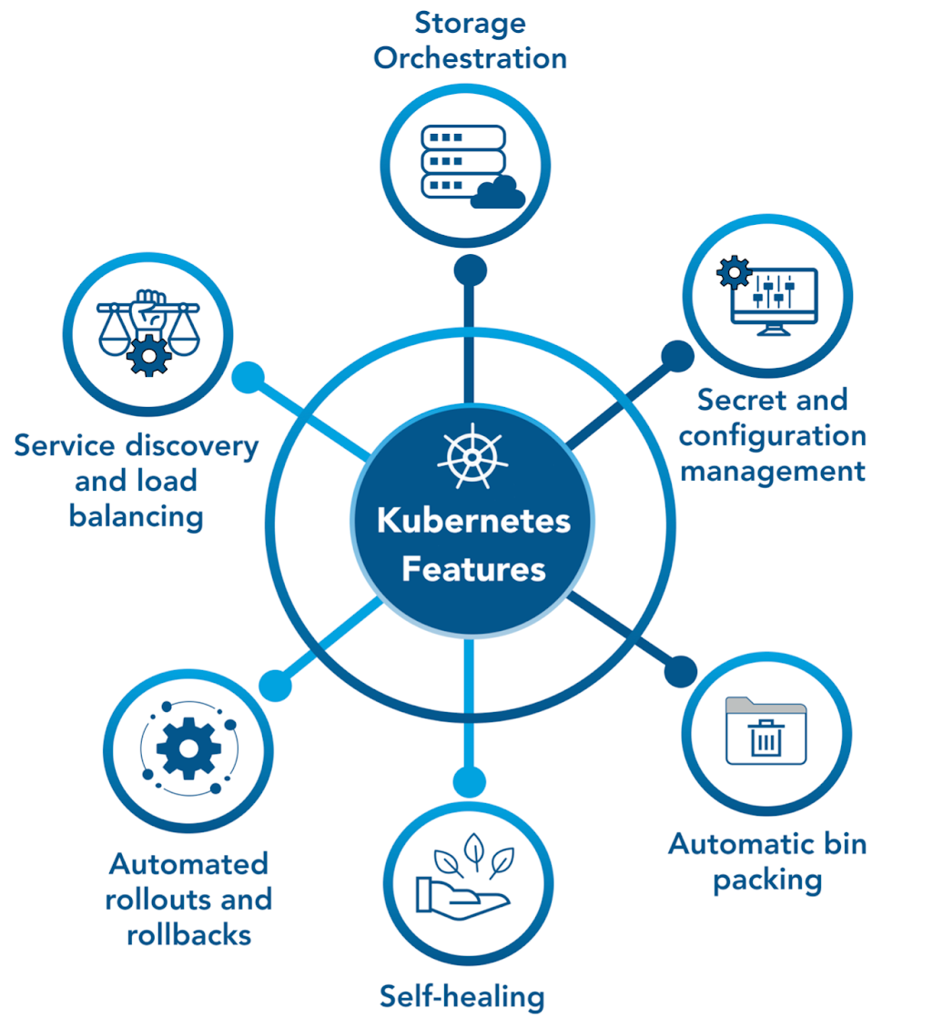
Kubernetes Features

Slide 21
Kubernetes Myths
Kubernetes is not:
To be compared with Docker
For containerizing apps
For apps with simple architecture
Kubernetes is actually:
Robust and reliable
A container orchestration platform
A solution for scaling up Containers
Backed by huge community
X
√

Slide 22
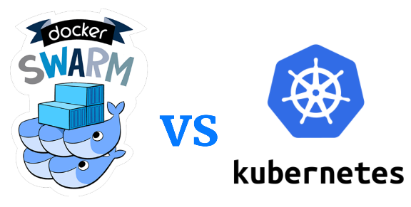
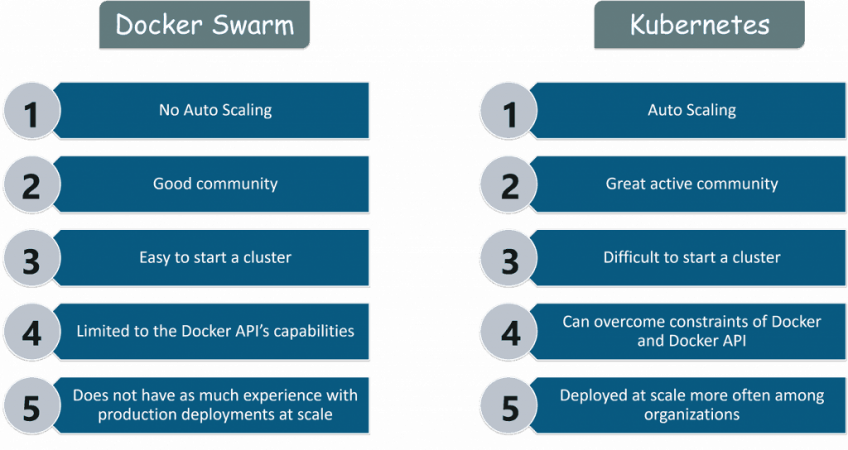
Kubernetes vs Docker Swarm

Slide 23
Kubernetes vs Docker Swarm
Features | Docker Swarm | Kubernetes
Installation and Cluster Configuration | Easy and Fast | Complicated and Time-consuming
GUI | Not Available | Available
Scalability | Scaling up is faster than K8S; but cluster strength is not as robust | Scaling up is slower but guarantees stronger cluster state
Load Balancing | Built-in load balancing technique | Requires manual service configuration
Updates and Rollback | Progressive updates and service health monitoring | Process scheduling to maintain services while updating
Data Volumes | Can be shared with any container | Only shared with containers in the same Pod
Logging and Monitoring | Only 3rd party logging and monitoring tools | Built-in logging and monitoring tools

Slide 24
Kubernetes Use Case

Slide 25
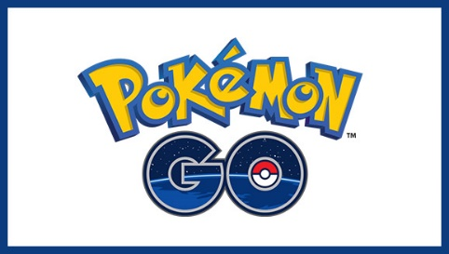
Kubernetes Use Case
Pokemon Go is an augmented reality game developed by Niantic for Android and iOS devices
Key Stats:
500+ million downloads, 20+ million daily active users
Initially only launched in NA, Australia and New Zeeland
Inspired users to walk over 5.4 billion miles in a year
Surpassed engineering expectations by 50 times

Slide 26
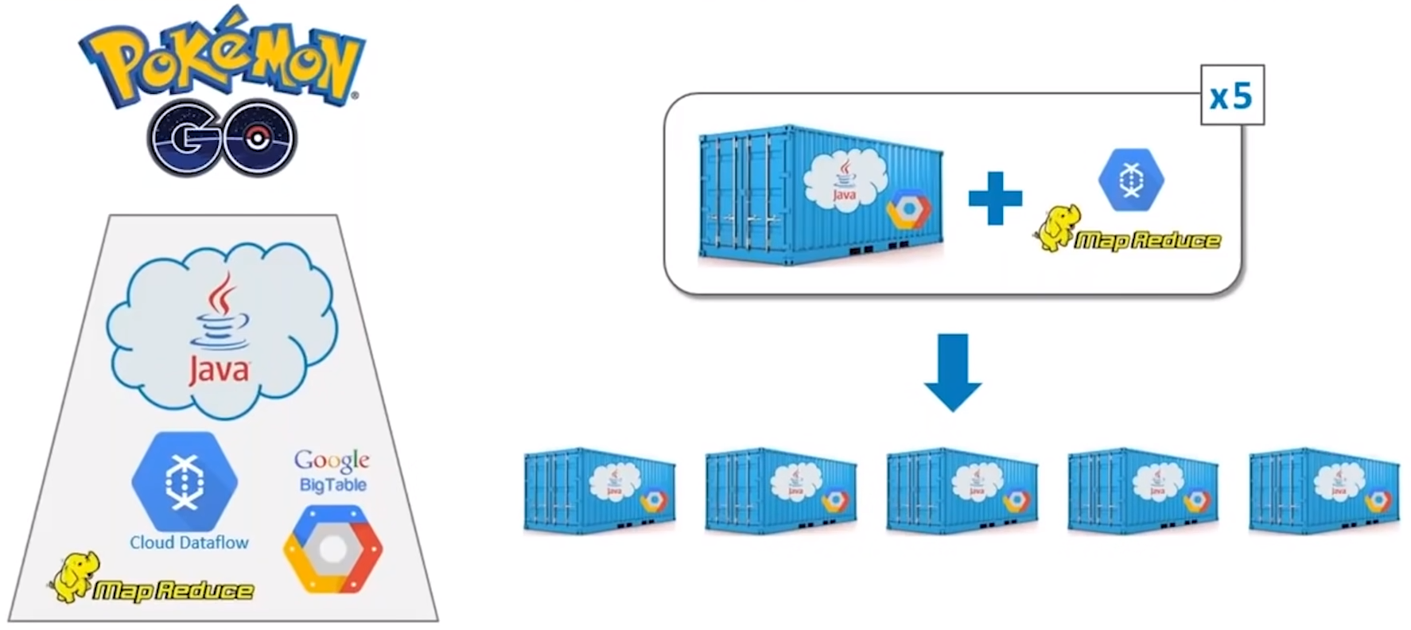
Backend Architecture

Slide 27
MapReduce & Cloud Dataflow for scaling up

Slide 28
Easy Scaling of Containers using Kubernetes

Slide 29
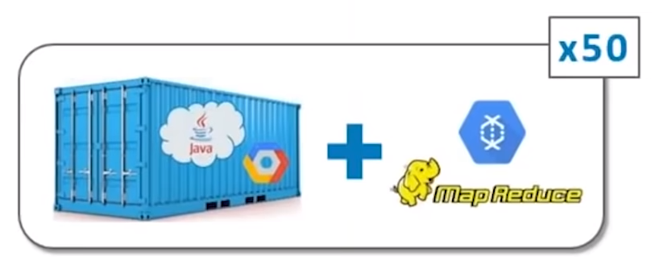
Easy Scaling of Containers using Kubernetes
Challenge
Biggest challenge fro most applications is horizontal scaling
For Pokemon Go, vertical scaling was an also a major challenge, because of real-time activity in gaming environment from millions of users
Niantic were prepared for traffic disasters of up to x5 times
Solution
Thanks to Kubernetes, Niantic were able to handle x50 times traffic

Slide 30
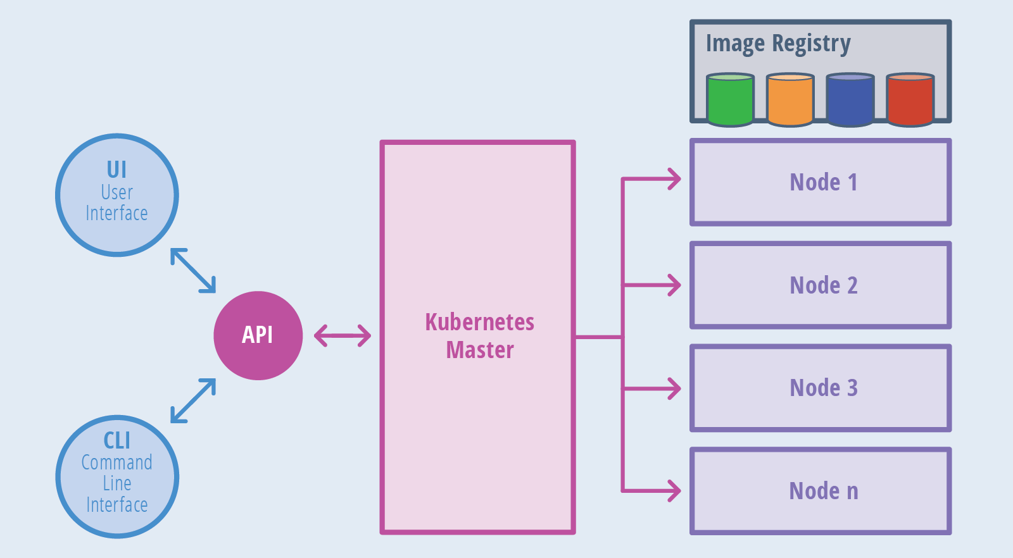
Kubernetes Architecture

Slide 31
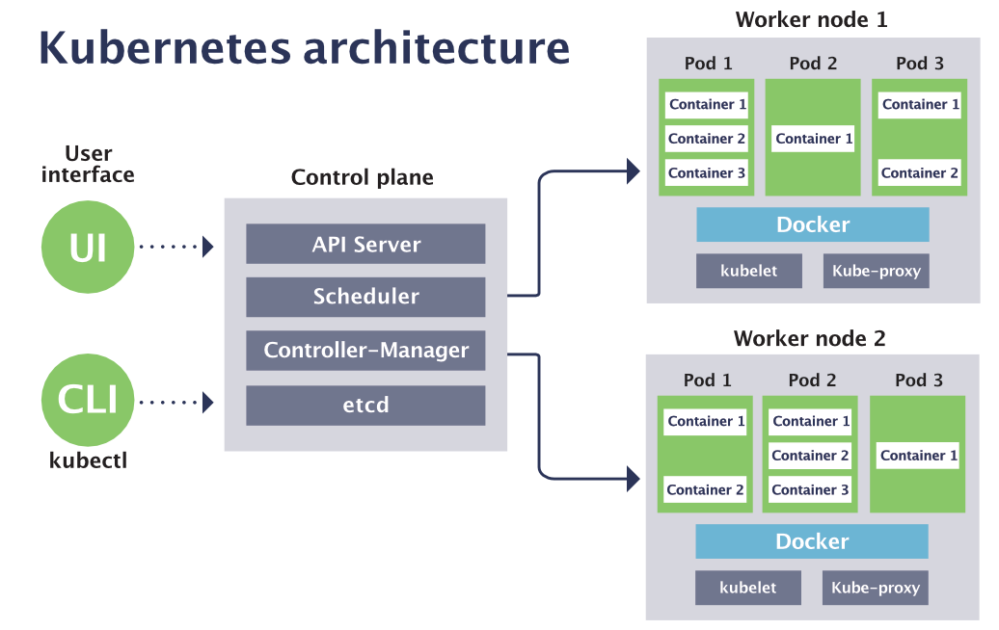
Kubernetes Architecture

Slide 32
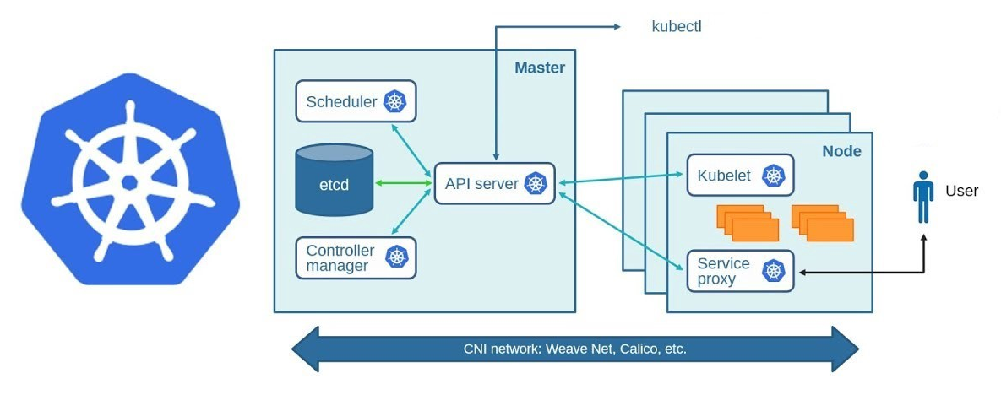
Kubernetes Architecture

